Slide 1
Introduction to
By Fahad Uddin
Advanced Internet Programming
CCNY, Mastars in CS Spring 2017

Slide 2

What is ?
Lightweight JavaScript library.
Where legacy browser is not necessary.

Slide 3

What is ?
Make JavaScript codes lighter
Works on latest browsers.
Developed by Rich Harris

Slide 4
What is ?
https://svelte.technology/
https://github.com/sveltejs/svelte
https://svelte.technology/guide

Slide 5
Why ?
Main idea,
“Frameworks without the framework”

Slide 6
Pros of ?
Less code.
Saves memory space.
Faster compile time.

Slide 7
Pros of ?
Simple and familiar.
Custom solution for component events.
Comes with state management.

Slide 8
Cons of ?
Relatively new.
Small community.

Slide 9
Vs
Vue.js simple easy.
Good documentation.
Simplified Angular.js

Slide 10
Vs
Intuitive Apis.
Configuration is smooth

Slide 11
Vs
Svelte.js is “All in One”.
JavaScript compiler.
Still growing.

Slide 12
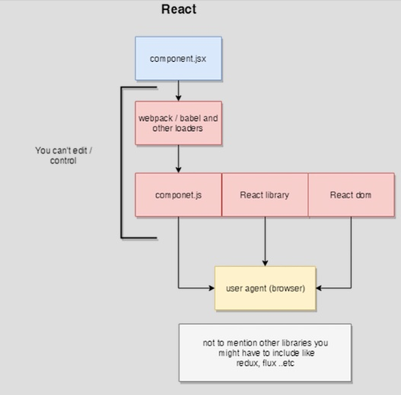
Vs

Slide 13
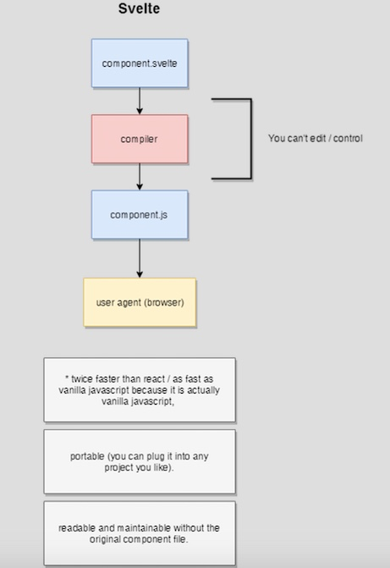
Vs

Slide 14
Requirements for
Knowledge about terminal/command prompt.
Installed Node.js
ruby -e "$(curl -fsSL https://raw.githubusercontent.com/Homebrew/install/master/install)"
brew install node

Slide 15
Requirements for
Primary knowledge about JavaScript.
Primary knowledge of HTML and CSS.
Any text editor.

Slide 16
Simple Example
Everything is ready?
Let’s see a simple example

Slide 17
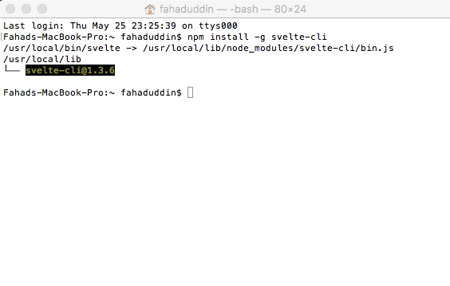
Simple Example
First install CLI.
npm install -g svelte-cli

Slide 18
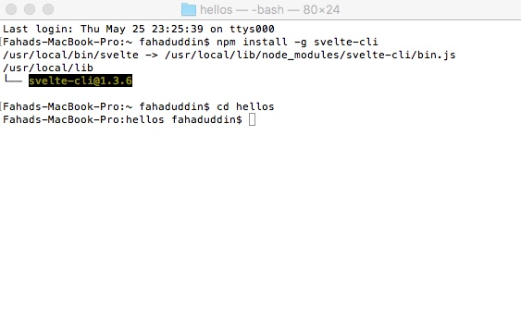
Simple Example
Make a directory “any name”.
Go to that directory.

Slide 19
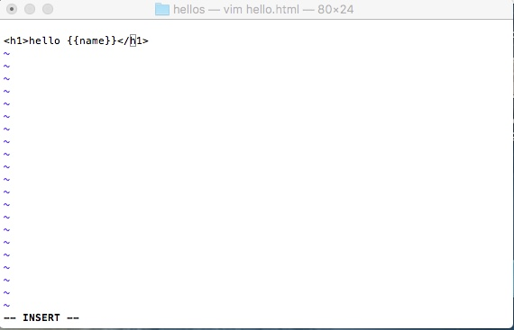
Simple Example
Inside that directory create hello.html

Slide 20
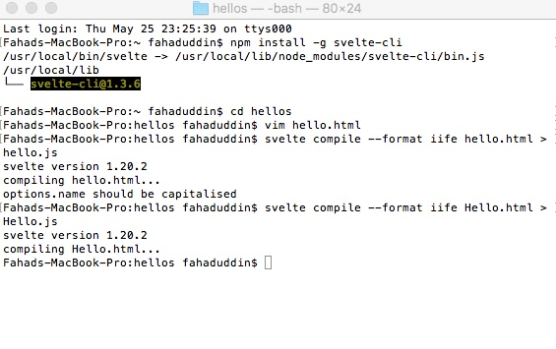
Simple Example
Now compile hello.html

Slide 21
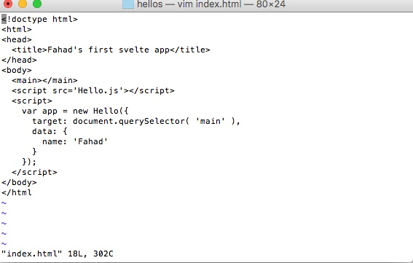
Simple Example
Now create index.html, including script.

Slide 22
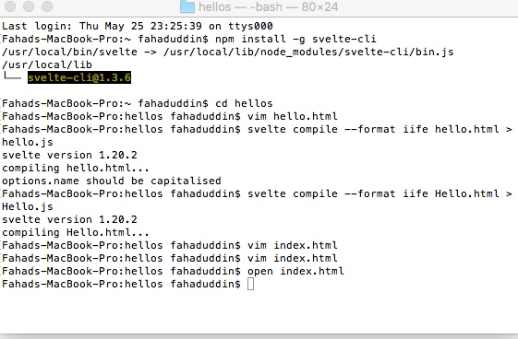
Simple Example
Now open index.html in browser.

Slide 23
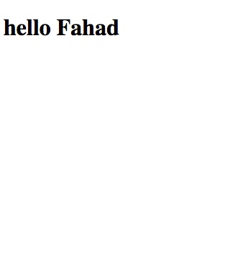
Simple Example
Output.

Slide 24
Simple Example
Let’s dig deeper.

Slide 25
Simple Example
Let’s dig deeper.

Slide 26
Simple Example
Rock collection app.
Have a list of rocks.
Have create, update and delete options.

Slide 27
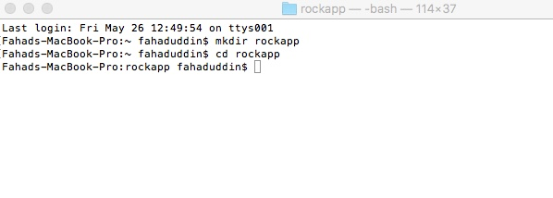
Simple Example
Making a directory “rockapp”.
Go to that directory.

Slide 28
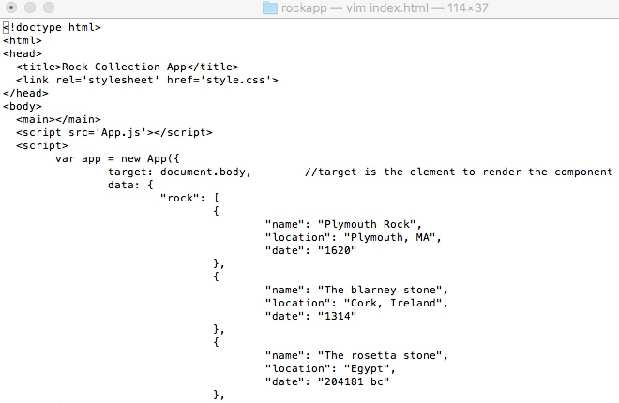
Simple Example
Now create index.html, including script.

Slide 29
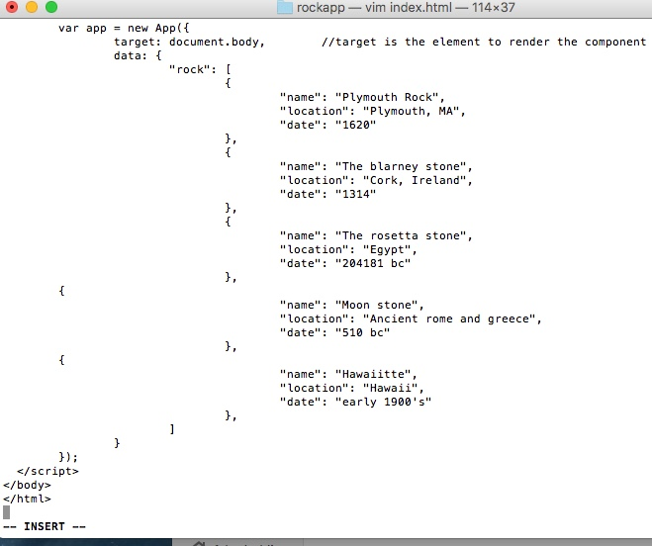
Simple Example
Now create index.html, including script.

Slide 30
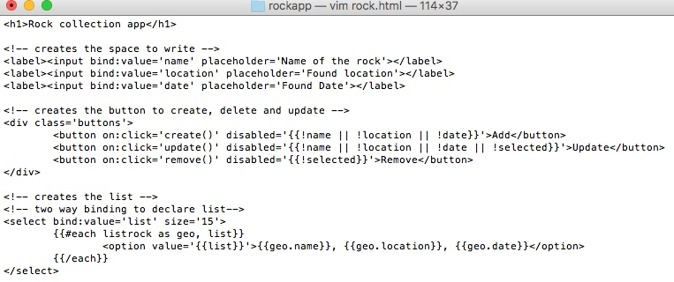
Simple Example
Now create rock.html, including script.

Slide 31
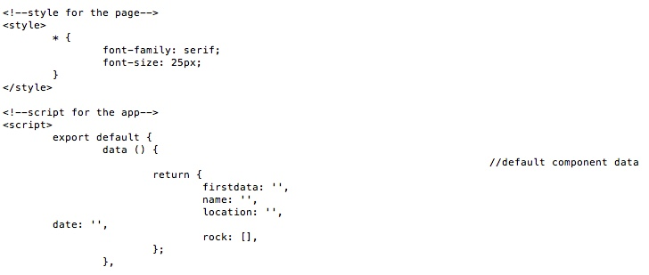
Simple Example
Now create rock.html, including script.

Slide 32
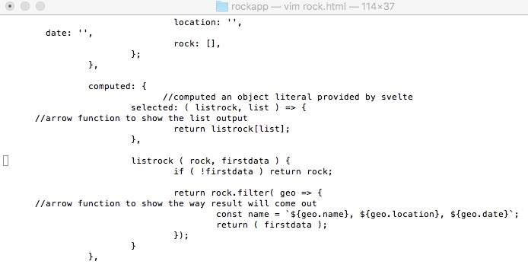
Simple Example
Now create rock.html, including script.

Slide 33
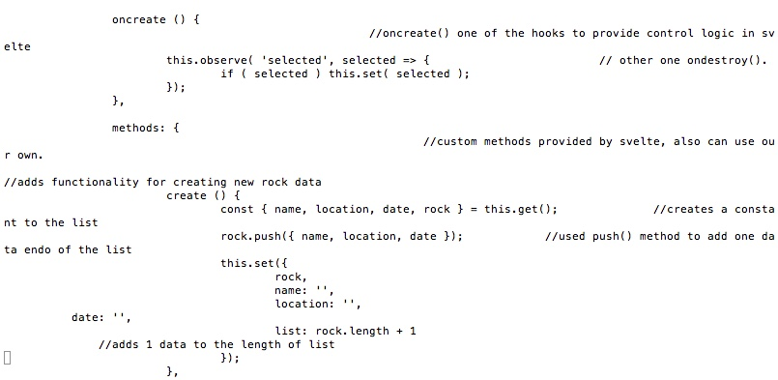
Simple Example
Now create rock.html, including script.

Slide 34
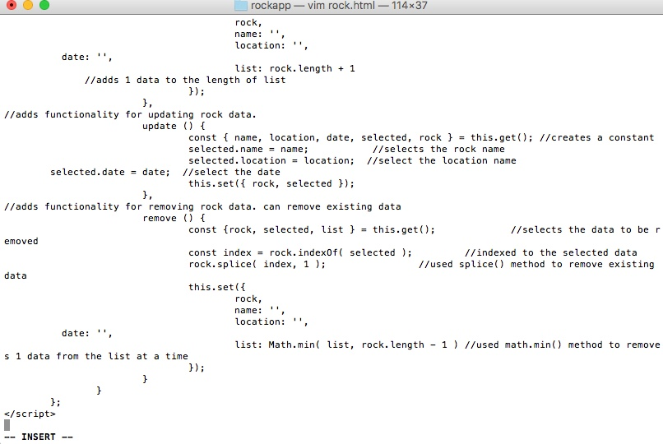
Simple Example
Now create rock.html, including script.

Slide 35
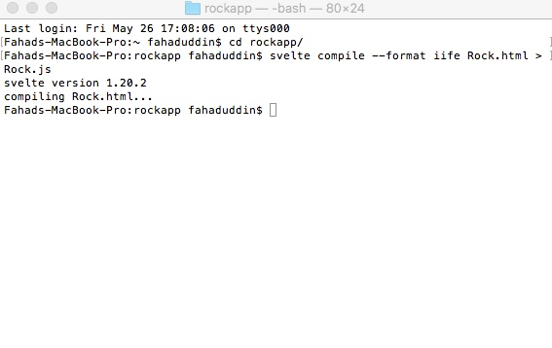
Simple Example
Now compile rock.html
svelte compile —format iife Rock.html > Rock.js

Slide 36
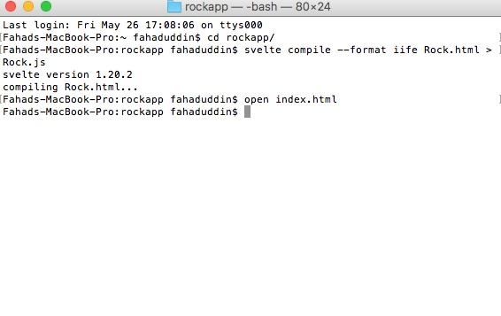
Simple Example
open index.html

Slide 37
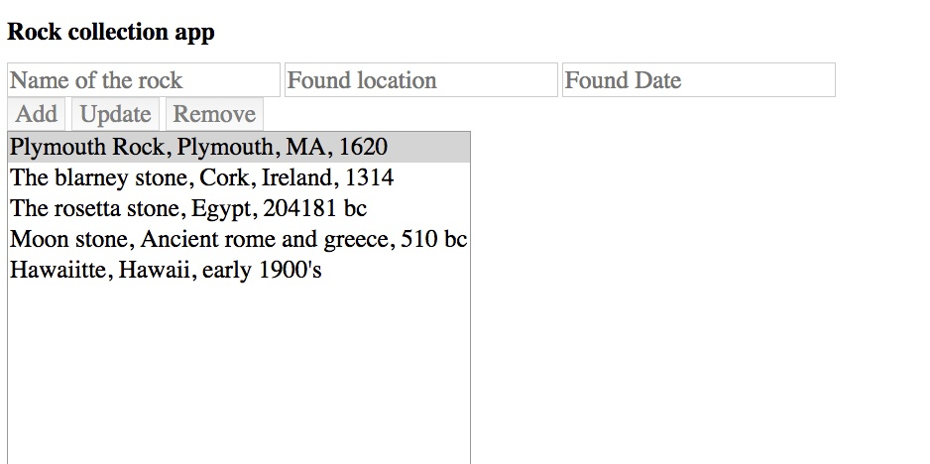
Simple Example
Result

Slide 38
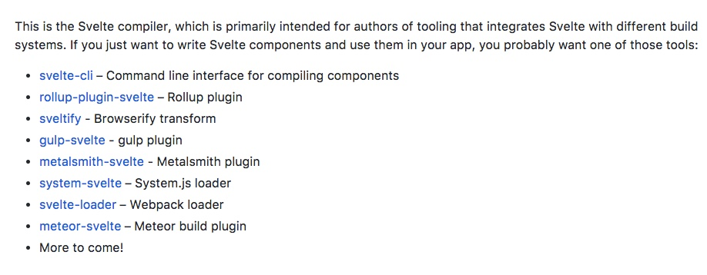
Compilers
List of svelte compilers.

Slide 39
Issues and Recommendation
Capitalization.
Use help page
https://svelte.technology/guide

Slide 40
Issues and Recommendation
Disscuss issues.
Follow readme.md file in the repo
https://gitter.im/sveltejs/svelte

Slide 41
References
https://svelte.technology
https://svelte.technology/guide
https://developer.mozilla.org/en-US/docs/Web/JavaScript/Reference
https://svelte.technology/guide

Slide 42
End of our
presentation.
Thank you!

